Slide 1


Harnessing data for storytelling
How Internews data journalism training makes meaning of complex data

Slide 2
What is data journalism?
“ Data journalism is the art and practice of finding stories in data…and then retelling them.”
“Data journalism unearths new sources of data using digital and social media tools to analyze and produce new stories .”
- School of Data & The Data Journalism Handbook

Slide 3




Why now?
Open data
culture
The dynamic nature of digital and data tools has transformed the media.

Slide 4
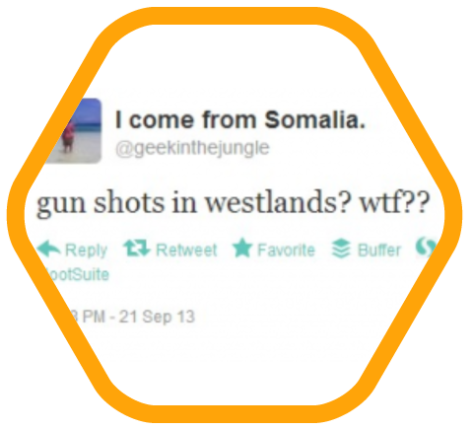


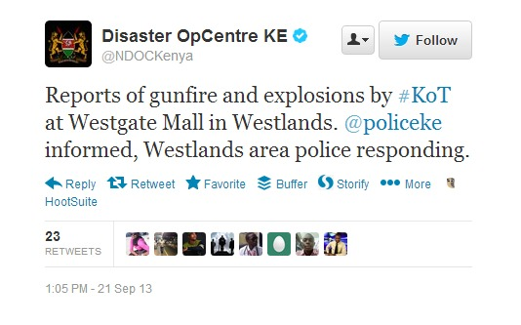
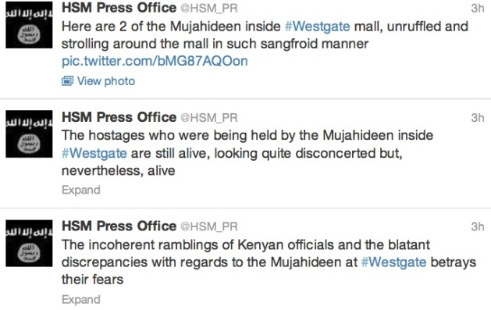
#Westgate – social media siege
The social media immediately broke the news.
Victims and their families called for help through Facebook & Twitter.
Police and government officials responded on official Twitter accounts.
And even Al-shabaab was tweeting.

Slide 5
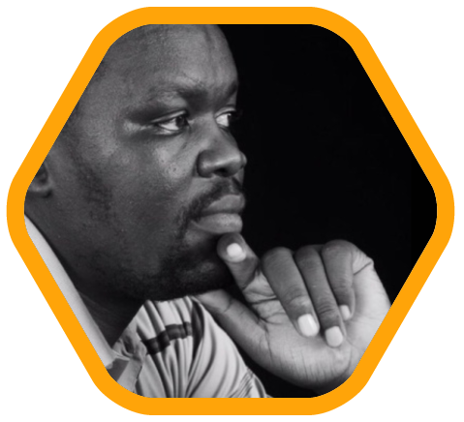
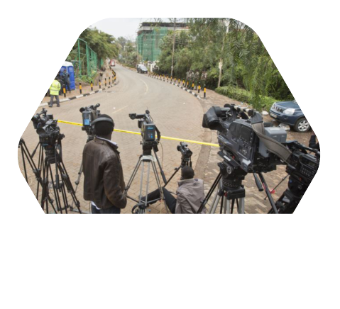
#Westgate – The role of the media
Lack of sound bites for radio and TV in initial stage.
Task for journalist became to verify.
Kenyan blogger, Robert Alai praised by Kenyans in diaspora.
(100,000 followers)

Slide 6
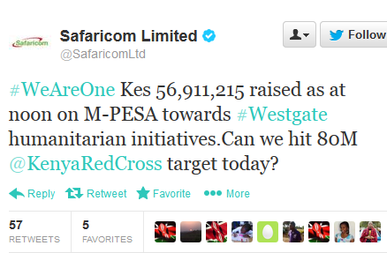
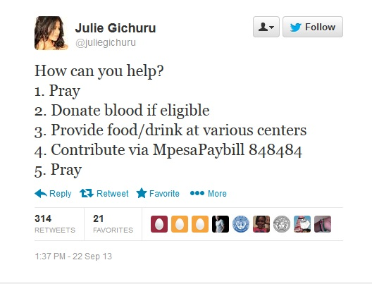
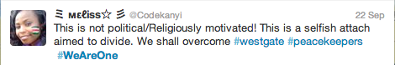
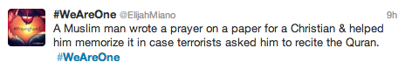
#Westgate – The social media campaign
#WeAreOne (by Red Cross & Safaricom)
Drive for blood donation
Fundraising
But the hashtag got a life of its own...

Slide 7
Why it matters
Data journalism cuts across sectors.
It transforms journalism into
a powerful tool
for accountability
and constructive engagement.
It analyses complex dynamics that cause political and development initiatives to succeed or fail, people to become sick or well and inequality to grow or shrink.

Slide 8
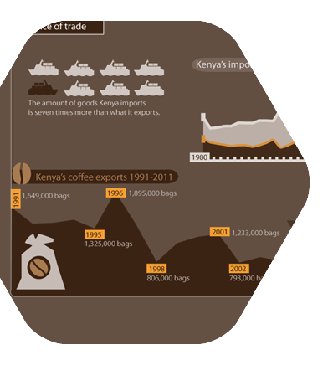
Our approach
Inclusivity
- brings together media,
civil society organisations, government bodies and experts.
Innovation
fosters creative solutions
and collaboration through trainings, travel grants fellowships and awards.

Slide 9


Our approach
Data literacy
- ensures that audiences are able to understand and make more informed decisions based on presented data.
Adaptability
recognises that learning data skills is a long-term process that requires sustained training and support.

Slide 10

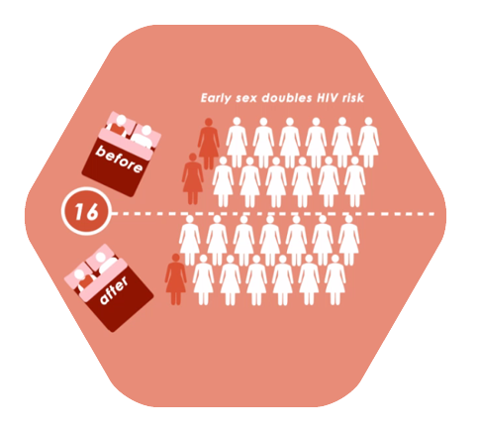
Mentorship
Exploring data exercises

Slide 11
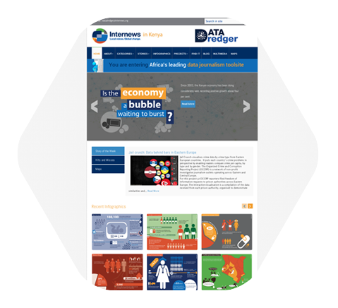


Data Dredger
To advance more data journalism in Kenya Internews created Data Dredger.
Here journalists can download data sets as well as visualisations to help them tell their stories.
It is considered Africa’s leading data journalism tool site.
Recognised
by the Global Editors Network.

Slide 12
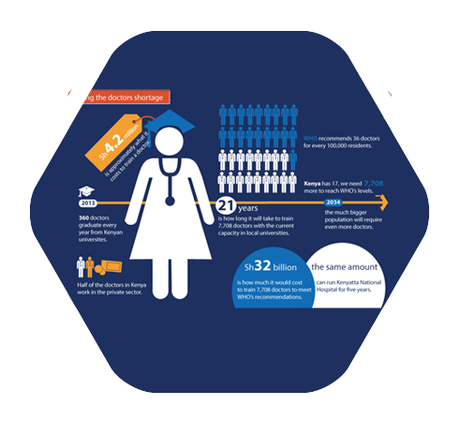
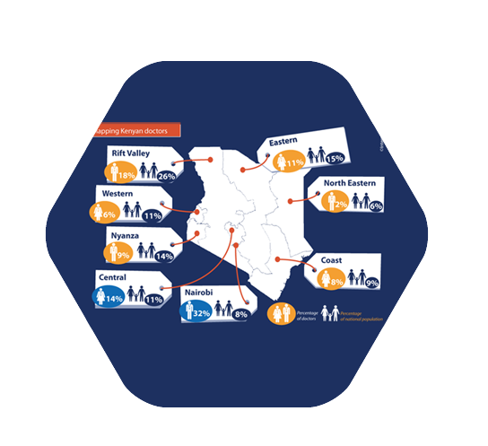


Politics of health
An audit of health sector data and the election promises by political parties and presidential candidates to enable journalists to fact-check the promises and to track post-election performance.

Slide 13
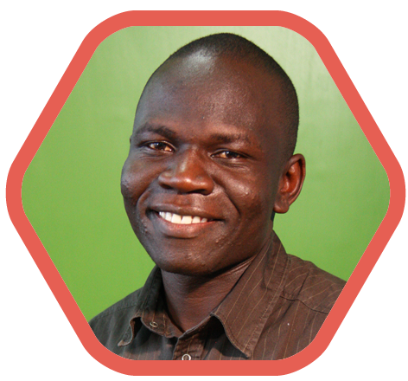

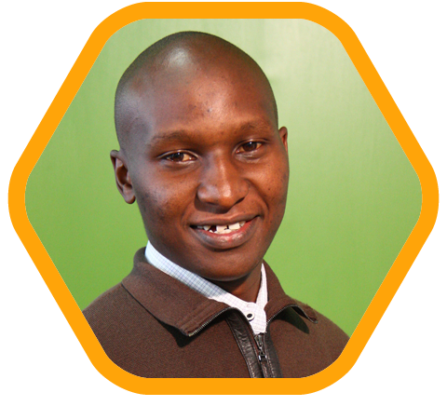

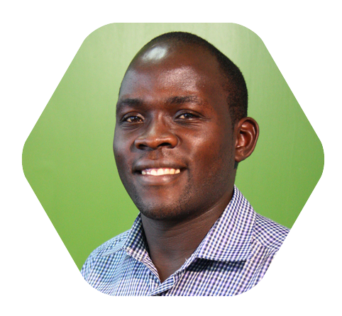
Fellowship
“Data has shaped the way
I look at facts, in the pursuit of truth in the stories I tell.”
Paul Wafula
Internews data journalism fellow and
winner of the 2014 David Astor journalism award.

Slide 14
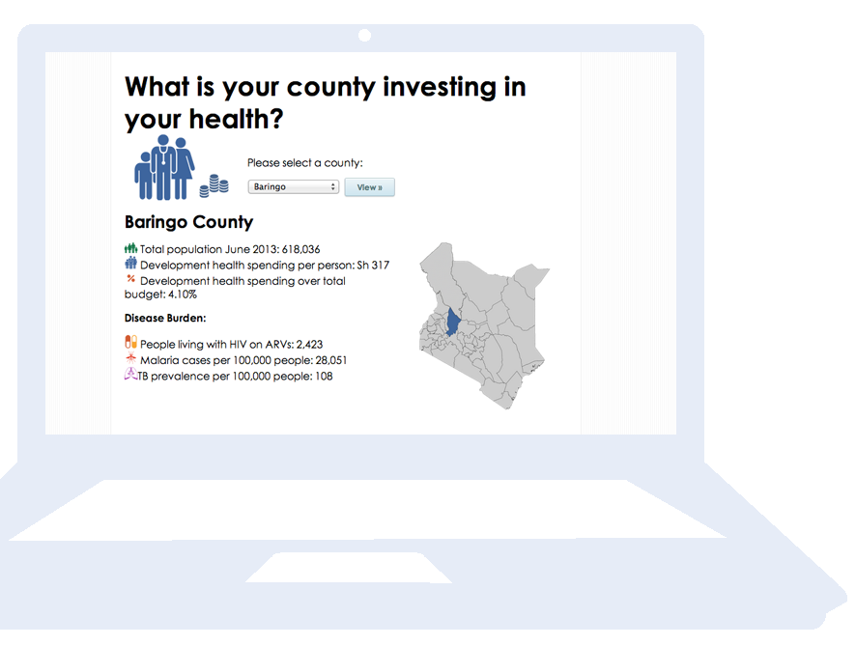
Award winning work
Among the topics the fellows explored were:
Cost of low contraception use
County health financing
Underlying causes of malnutrition in Turkana
Corruption in safety net program
The project has been recognized for its contribution to the open data movement by the Open Knowledge Foundation's Partnership for Open Data.

Slide 15
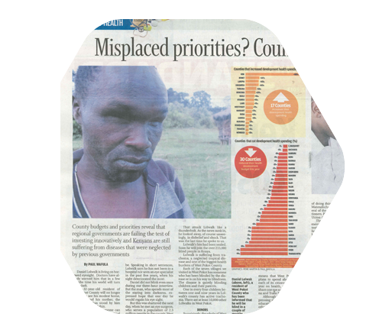
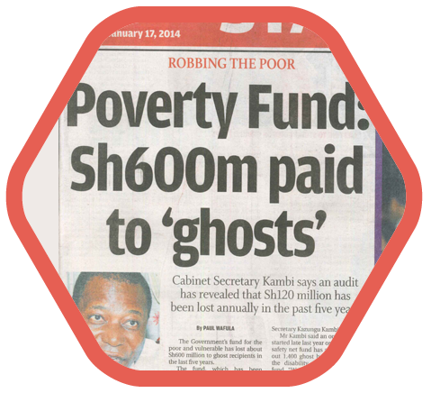
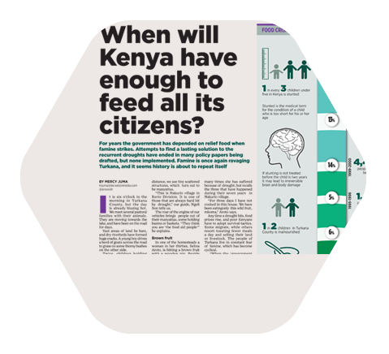
Impact & policy change
Took the health funding debate to the county level by providing access to data on health spending
by the public sector in 2013.
Made the minister order an audit and the Labor Cabinet Secretary reveal that Sh600 million were handed out to ghost recipients. Enlisted Safaricom, to help distribute the funding.
Set the news agenda. Main character got assistance and a relief fund for Turkana County was set up jointly with Red Cross.

Slide 16


Data
A perfect springboard
to tackle public health topics, and to track spending and social development.

Slide 17

Inspiring storytelling
The data set created interest in newborn health among journalists. Many stories were published between October and December.
Shortage of incubators a health crisis
The Daily Nation
Kangaroo care crucial for survival of premature babies.
The Star
Doctors raise a red flag on incubator shortage K24

Slide 18
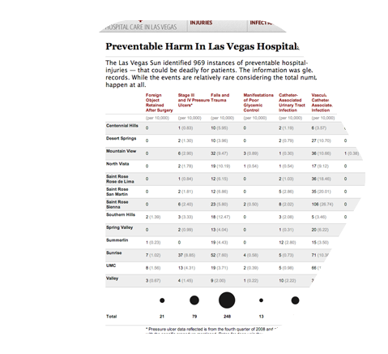

Do no harm
A two-year investigation by Las Vegas Sun reporters Marshall Allen and Alex Richards revealing thousands of cases of injury, death and deadly infection caused by negligence during hospital stays.
Includes interviews with more than 150 patients and health care insiders, and records of every Nevada hospital inpatient visit going back a decade
— 2.9 million in all.

Slide 19
Homework
Find the award winning stories by Internews fellows on Data Dredger and read/view them.
Go through the Do no harm article ahead of a review session on Thursday.

